Slide 1

Seminar 9
UBIQUITOUS SENSOR NETWORK LABORATORY
Department of Electronics Engineering, Keimyung University
23th June 2016
By Tran Viet Cuong

Slide 2
Machine Learning
Neural Network:
A perceptron Learning
Multi-Perceptron Learning
Support Vector Machine
How to implement Algorithm on Python through examples ^{[1]}

Slide 3
Machine Learning
How to handle with data?
Nominal Data (color, not sorted or ordered)
Ordinal Data (ordered or sorted)
Parameters and arguments:
Features
Learning rate
Loops
…
-> to avoid overfitting and get the highest accuracy

Slide 4
EMG
Training Data:
For each gesture takes 1256 samples
DWT level 3: using cA3 and cD3 to extract MAV and RMS features and label classifications ^{[2]}
Fit features and into SVM or MPL
Predicting data:
256 samples for each window
DWT
Predict data
Note:
Adjusting parameters and features for accuracy
Getting Data and Processing Data should be implemented in 0.3s

Slide 5
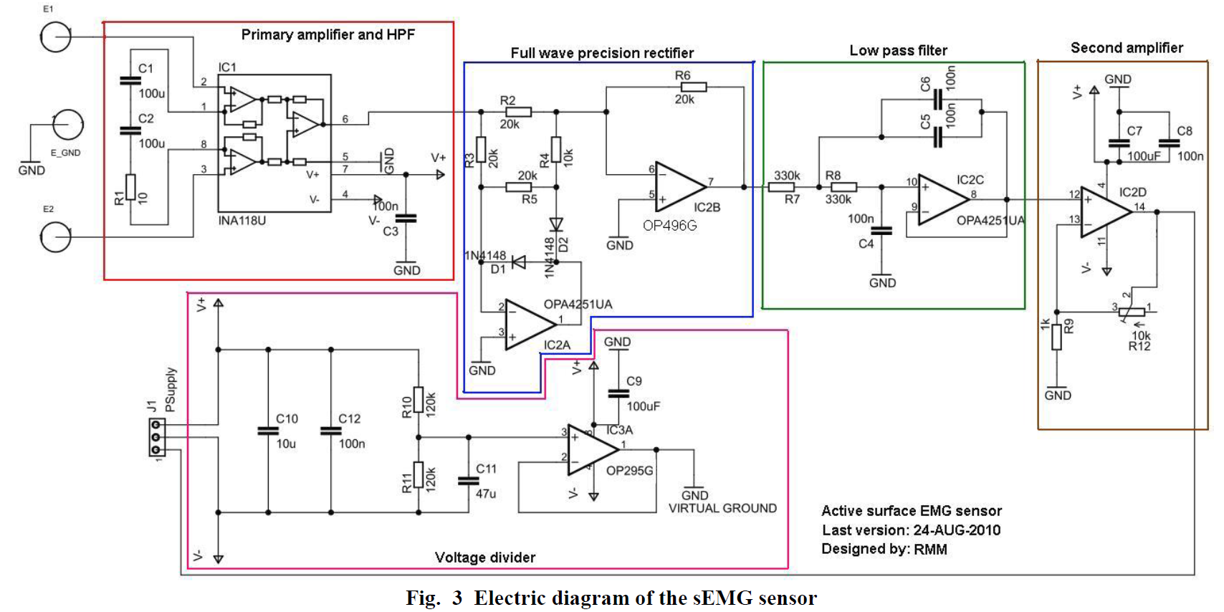
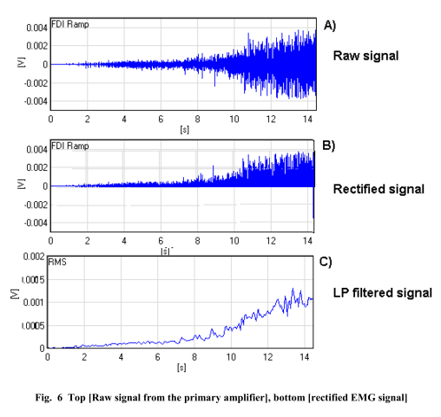
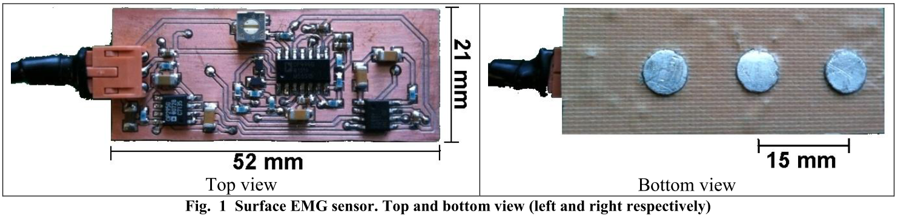
Active EMG for dry Electrodes ^{[3]}

Slide 6
in next 2 weeks
Trying to make active EMG
Try to make application for IMU + EMG
UBIQUITOUS SENSOR NETWORK LABORATORY

Slide 7
Reference
[1] Python Machine Learning (Sebastian Rashka)
[2] Wavelet Analysis based feature extraction for pattern classification from Single channel acquired EMG signal (Sachin Sharma and Gaurav Kumar)
[3] Active surface electromyography sensor (link)
[4] link
UBIQUITOUS SENSOR NETWORK LABORATORY

Slide 8
Any Questions ?
UBIQUITOUS SENSOR NETWORK LABORATORY

Slide 9
THANK YOU!
UBIQUITOUS SENSOR NETWORK LABORATORY

